Slide 1

Hotel Database
Presented By :
Rida Abdulwasay – Pro Team Coordinator
Ameya Dighe – Screen Output Expert
Alvin Fabrio – Hash Table Whiz
Daozhen (Leslie) Liu – BST Algorithms Specialist
Samantha Tancio – Presentation Guru
Vinh Vu – File I/O Ace

Slide 2


What Will Be Covered?
What is our project/Why we chose it
Overview of the following :
Data Set room number, type of room, check-in, guest name, etc.
Data Structures to be presented with UML diagrams
Scenarios, feedback and errors encountered
Live Demo of Project

Slide 3



What is the Hotel Database?
It is designed to mimic a real-life database located in hotels that stores basic information about guests and their reservations.
Why Choose This Topic?
Hotels are a crucial aspect in the tourism.
Virtually all tourists have stayed in a hotel.

Slide 4


Overview : Data Set
Due to the fact that hotel guest data is confidential, our team had to compromise and create our own data set.
Our database has the following fields:
Room Number (String) – unique key
Guest Name (String) – secondary key
Type of Room (String)
Stay Duration (Int)
Number of People Staying (Int)
Price (Int)

Slide 5
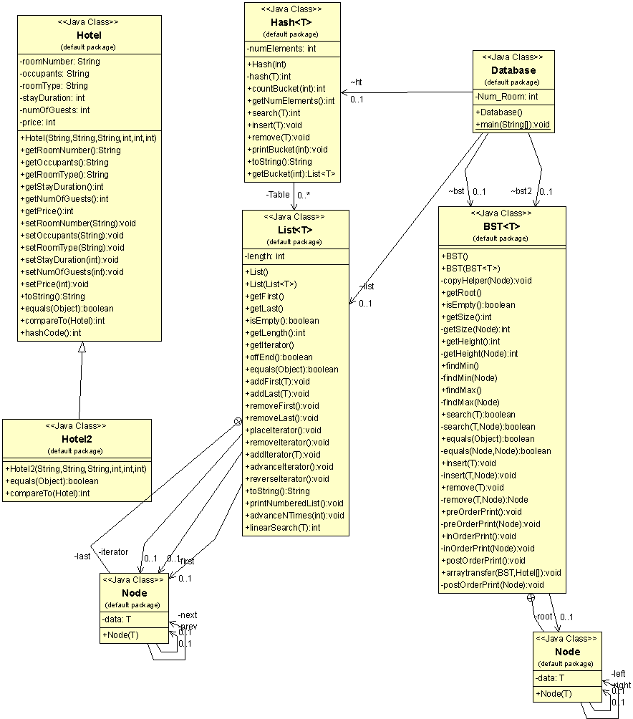
Overview of Data Structures
Notes:
Important: In this part of the presentation, you need to describe in detail your solution to the requirement of the two BSTs

Slide 6
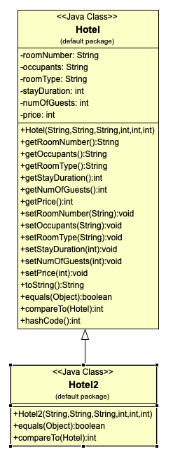
Hotel Class
Room Number: Unique Key
Occupants: Secondary Key

Slide 7
Database
Screen output class
2 Bst, one that takes in data with room Number and a second that takes in data with occupants.
1 Hash Table that stores hotel data from file
1 List containing occupant hotel data
Several local variables

Slide 8
Walk-Through Results :
Scenarios, Feedback, Errors.
Scenario 1: “ Make a Hotel Reservation” :
Scenario 2: “Search for it” :
Scenario 3: “Print Guest Data by Name” :
Feedback from Participant 1:
Good program! Just wished it had GUI.
Feedback from Participant 2:
Nice job! Maybe it could have more variable fields when making reservations (i.e. floor number, location, kids/no kids).
Errors Noted: Just some minor formatting errors

Slide 9
Live Demo…

Slide 10

THANK YOU!

